Slide 1
Bakery website project
Yuki Shiraishi

Slide 2
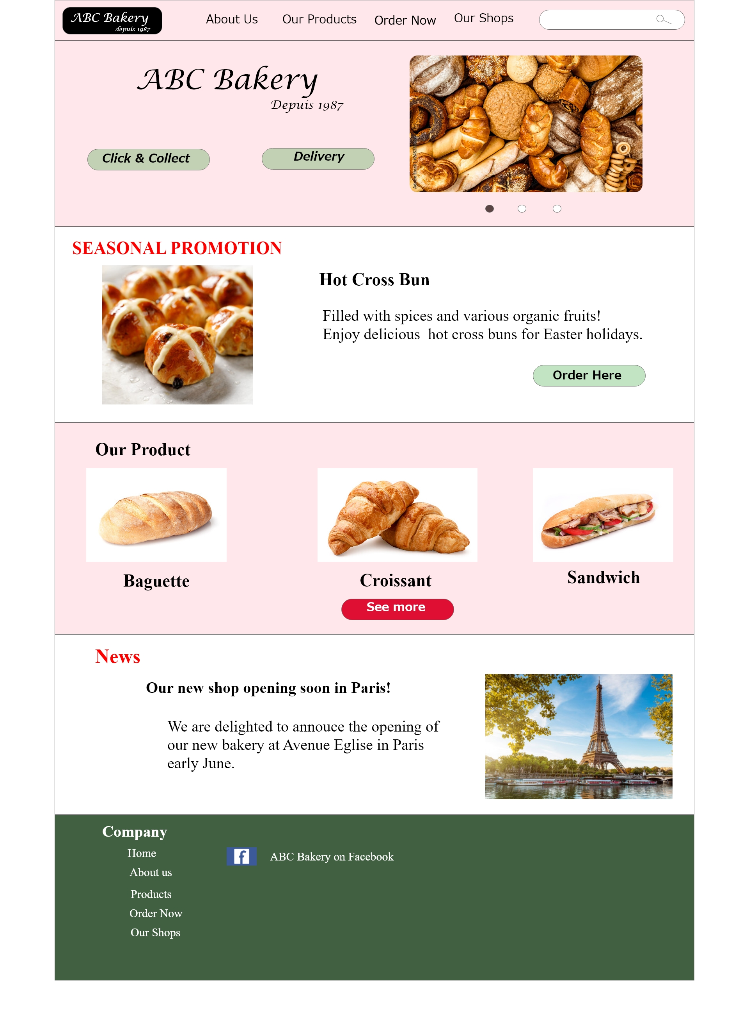
Project overview
The product:
ABC Bakery is a regional bread maker located in suburbs of Brussels. ABC Bakery is well known as they use organic ingredients and also offer healthy, various sandwiches etc. Their target customers are local families, workers who are busy to prepare meals for their family.
Preview of selected polished designs.
Project duration:
February 2023 to March 2023

Slide 3
Project overview
The problem:
Busy parents and workers lack the time necessary to go to buy fresh bread to prepare meals. Sometime they can’t buy them because they go to the bakery too late. They want some tools to order in advance.
The goal:
Design a website for ABC Bakery that allows users to easily order, pick up and deliver fresh, healthy bread and sandwiches.

Slide 4
Project overview
My role:
UX designer designing a website for ABC Bakery from conception to delivery.
Responsibilities:
Conducting interview, paper and digital wireframe, low and high fidelity prototyping, conducting usability studies, accounting for accessibility, and iterating on design.

Slide 5
User research
Personas
Problem statements
User journey maps
Understanding
the user

Slide 6
User research: summary
I conducted interviews, and created empathy maps to understand the users. A primary user group is working parents who take care of their family and serve meals .
This research shows not only they want to save their time but also some parents prefer fresh bread in the bakery to processed products in supermarket which contains chemical ingredients. Moreover, from Bakery owner’s point of view, introducing website may lead to get new customers.

Slide 7
User research: pain points
1
2
3
Out of stock
Time
Fresh and Healthy food
Working parents are usually go to bakery after work and find all product are gone.
Delivery order by using website saves time and makes it easier to prepare meals for their families.
Bread in supermarket contains some chemical ingredients. Parents want to buy more healthy fresh food directly from bakery for keeping their family healthy.

Slide 8
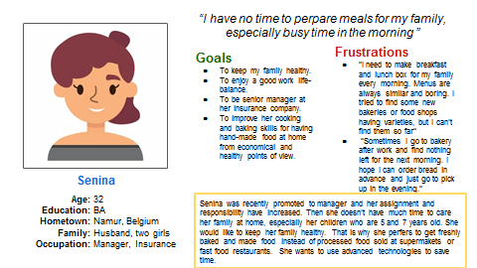
Persona: Senina
Problem statement:
Senina is a working mother with two small children who needs healthy meals with varieties because she is always busy and doesn’t have time to prepare and make meals for her family.

Slide 9
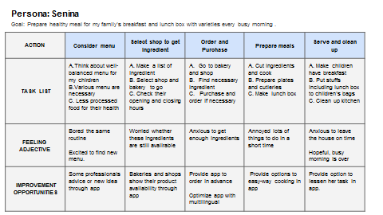
User journey map
Senina is busy working woman who needs to take care of her family, especially two small children. Bakery website would help her to provide healthy daily bread easier and save time and enrich her life.
Image of user journey map

Slide 10
Sitemap
Paper wireframes
Digital wireframes
Low-fidelity prototype
Usability studies
Starting
the design

Slide 11
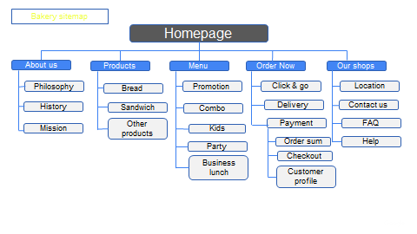
Sitemap
My goal to create the sitemap of Bakery website is making easy and simple navigation for busy people.
Image of sitemap/IA

Slide 12
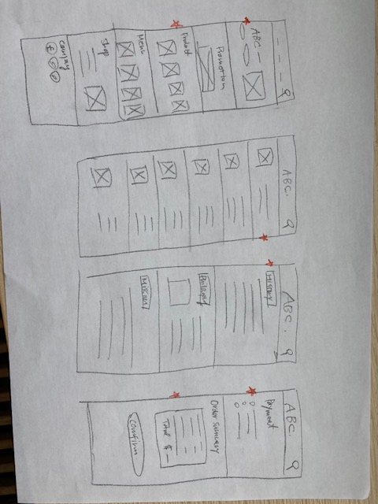
Red stars were used to mark the element of each sketch that would be used in the initial digital wireframe.
Paper wireframes
Our website would make users easy to process their order in advance to get fresh and healthy bread. We show main products first, then users can choose them smoothly.
Image of paper wireframes

Slide 13
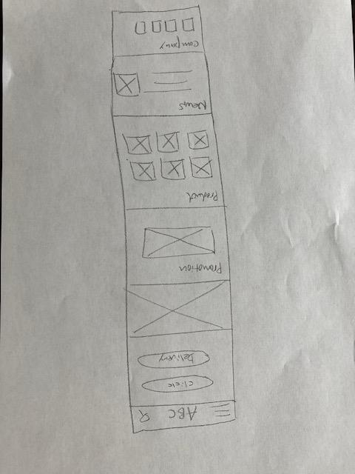
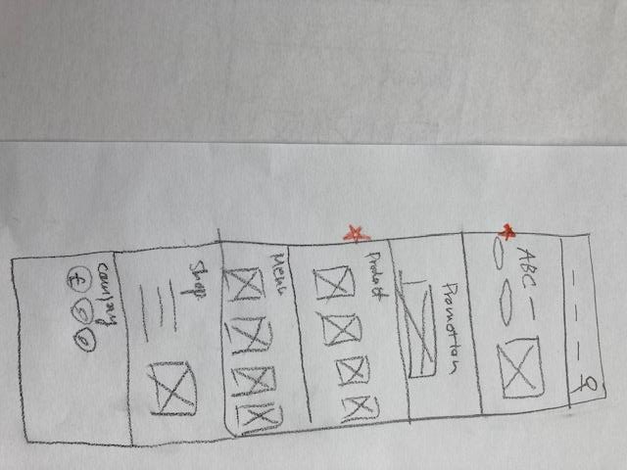
Mobile
Paper wireframe
screen size variation(s)
Website
Customers of ABC Bakery access the site on a variety of different devices, I started to work on designs for additional screen sizes to make sure the site would be fully responsive.
Image of paper wireframe screen size variation(s)

Slide 14
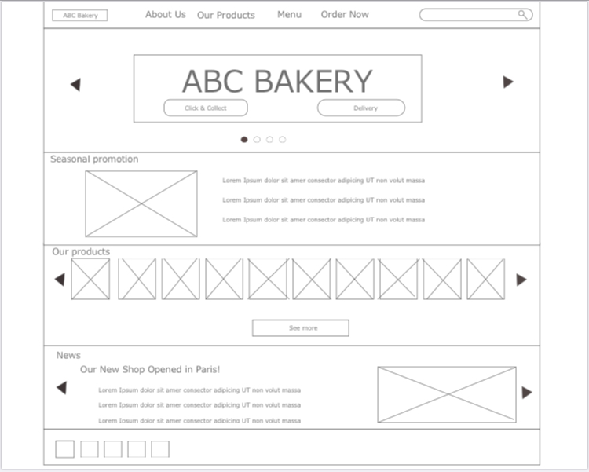
Digital wireframes
We started creating the digital wireframes from paper wireframe by focusing on improving the usability of users.
Insert first wireframe example that demonstrates design thinking aligned with user research
Easy to know promotion product
Users can see their products from homepage screen

Slide 15
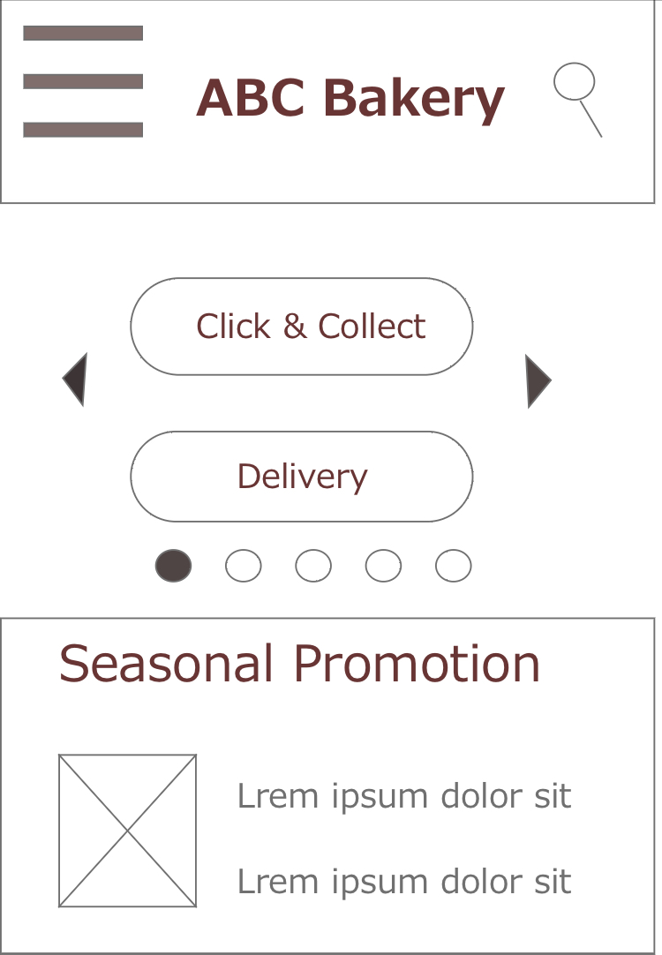
Digital wireframe
screen size variation(s)
Insert wireframe example that showcases
different screen size variations

Slide 16
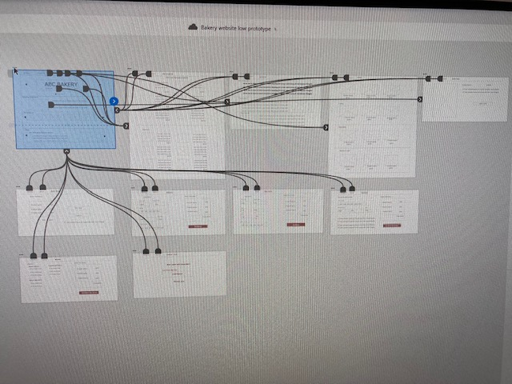
Low-fidelity prototype
The low-fidelity prototype connected the primary user flow of ordering bread and sandwiches. This prototype could be used in a usability study with users.
View the Bakery website
https://xd.adobe.com/view/4153bde9-fe3a-4ab7-af8c-5e6f84760058-1400/
Screenshot of prototype with connections or prototype GIF

Slide 17
Usability study: parameters
Study type:
Unmoderated usability study
Location:
Belgium, remote
Participants:
5 participants
Length:
20-30 minutes

Slide 18
Usability study: findings
There were the main findings uncovered by the usability study.
1
2
3
Easy way to select products
Map to find shops
Cancel option
Users want to select product easily with pictures.
No option for users when they want to cancel their orders.
Users didn’t find their shop without map.

Slide 19
Refining
the design
Mockups
High-fidelity prototype
Accessibility

Slide 20
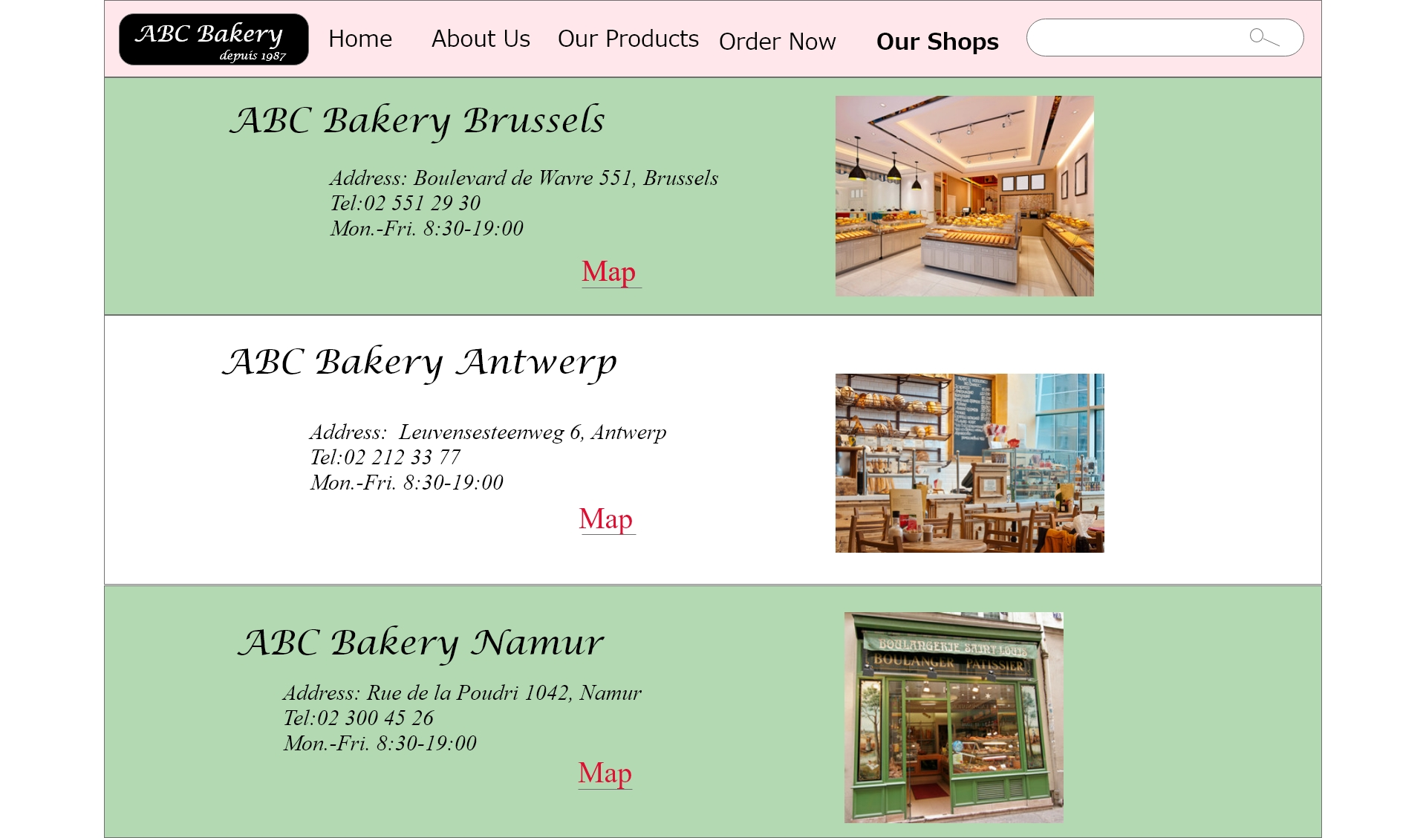

Mockups
Based on the insight from the usability study, I added the link of map for each bakery shop. This makes users easier to find where to go.
Before usability study
After usability study
Mockup 1 before
Mockup 1 after

Slide 21
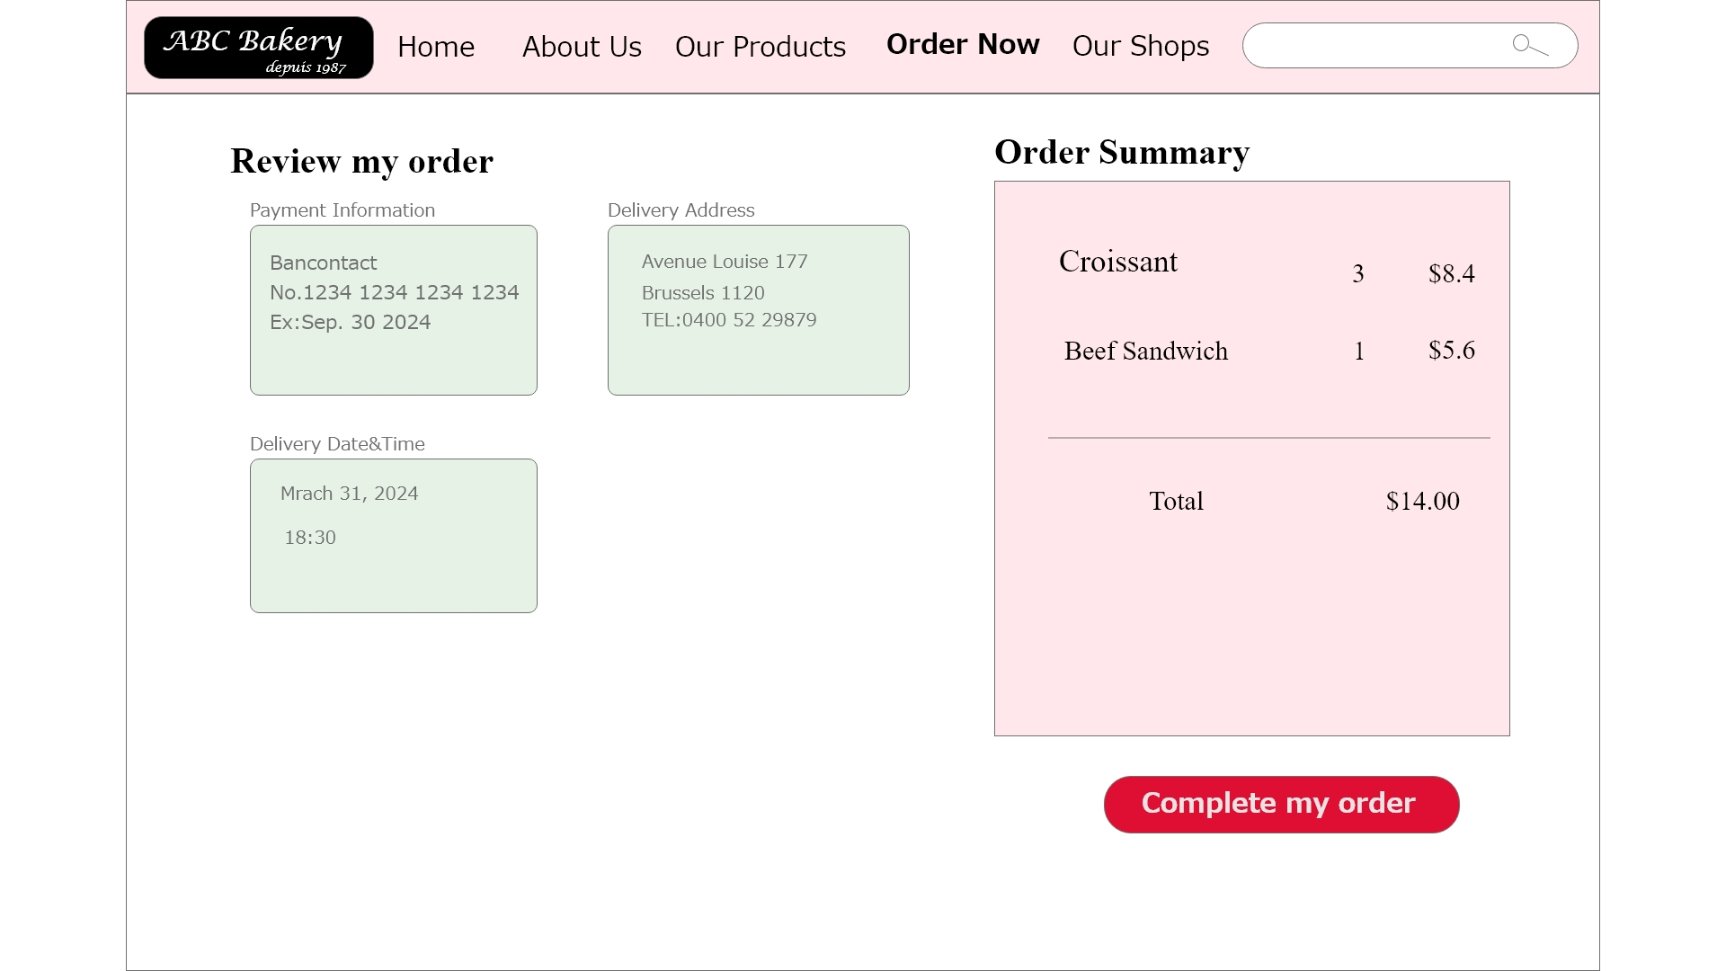

Mockups
To give users a cancel option, I added the cancel button that allows users to cancel their orders.
Before usability study
After usability study
Mockup 2 before
Mockup 2 after

Slide 22
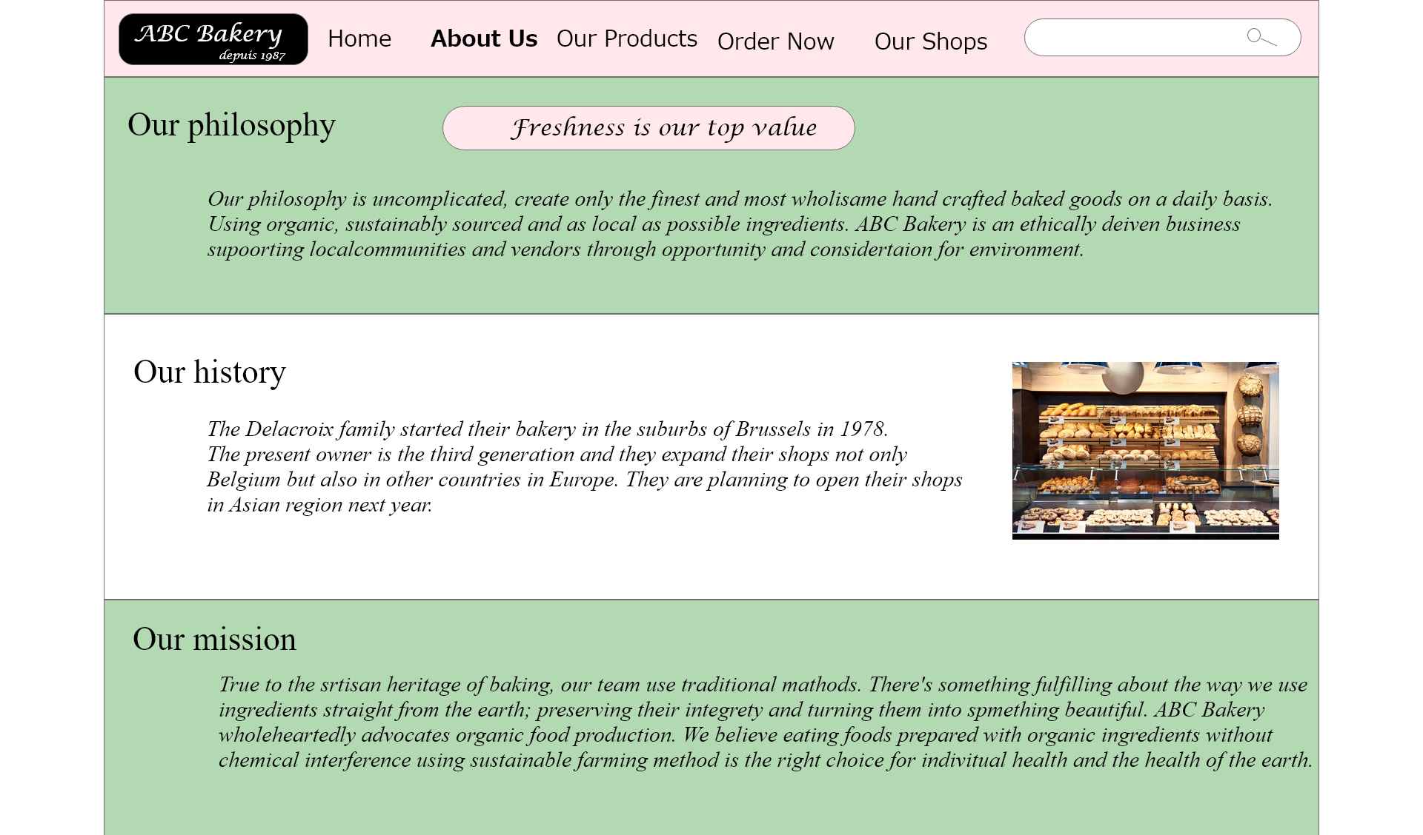
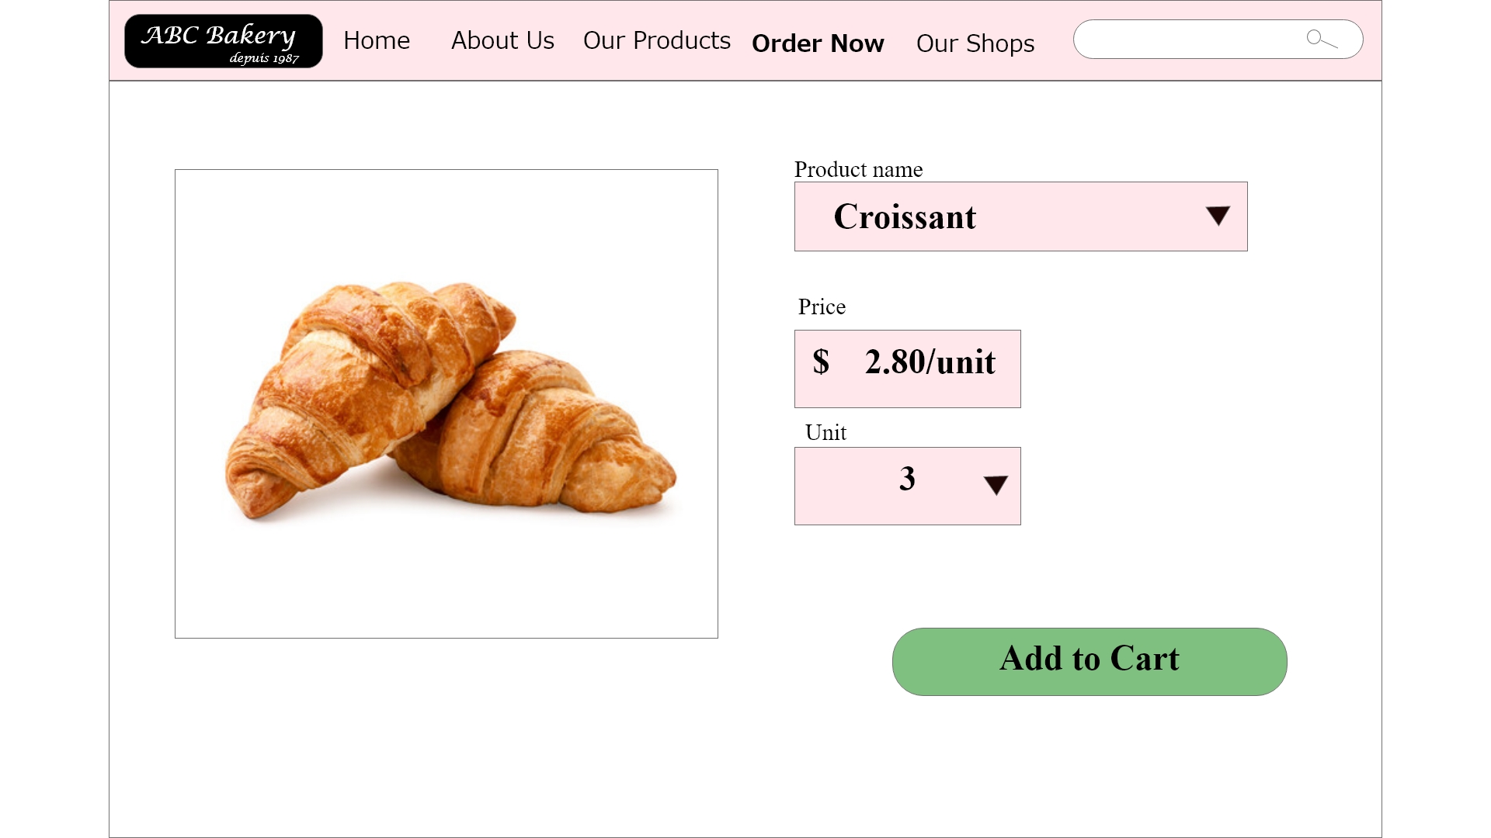
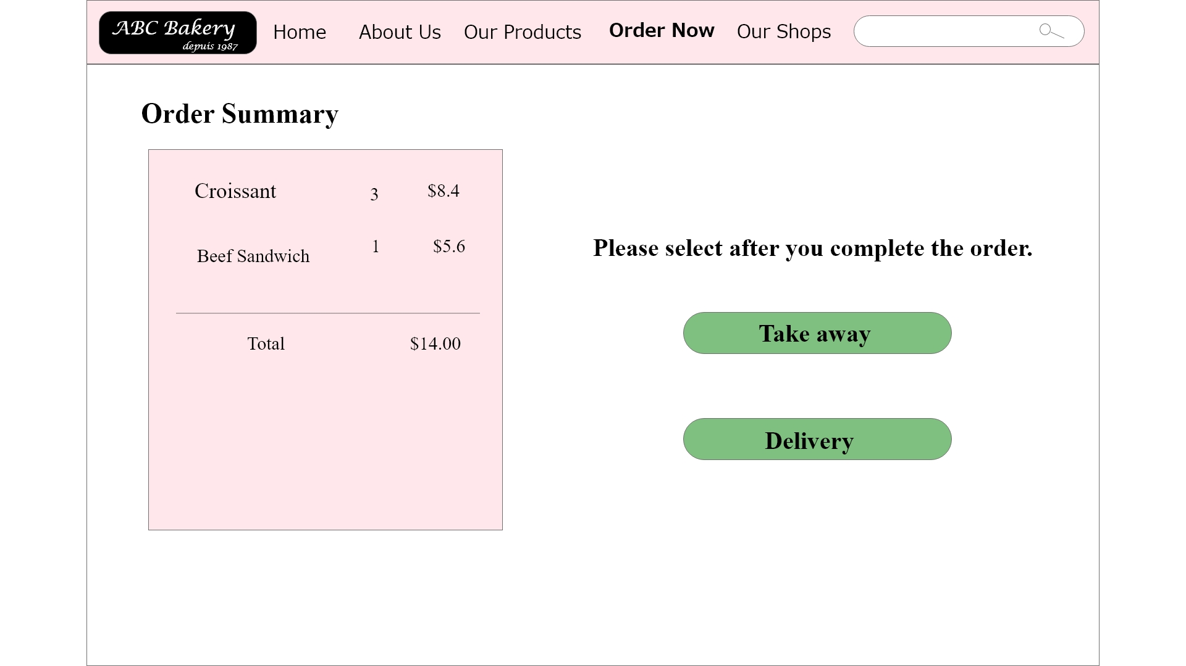
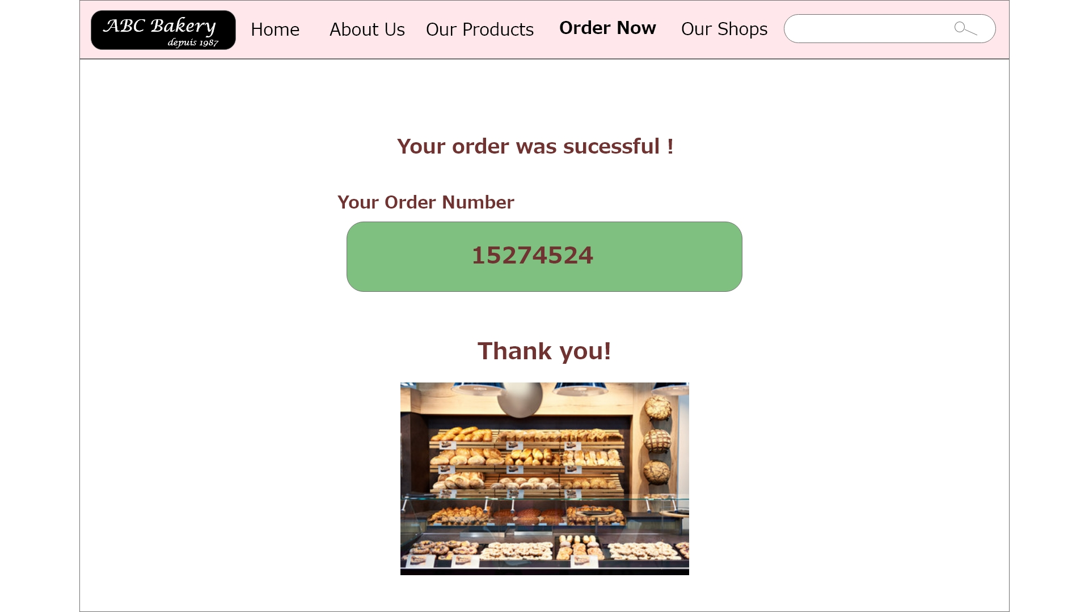
Mockups: Original screen size
Main mockup screen for display
Main mockup screen for display
Main mockup screen for display
Main mockup screen for display

Slide 23
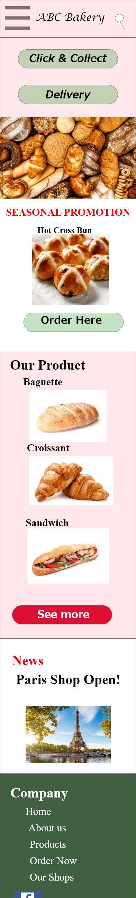

Mockups: Screen size variations

Slide 24
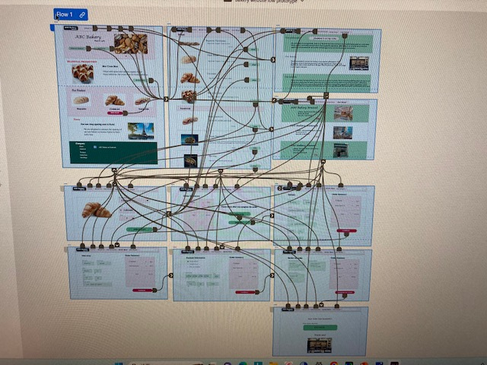
High-fidelity prototype
The final high- fidelity prototype presented clear user flows for ordering a bakery website. This includes design changes based on usability studies.
View the Bakery website
https://xd.adobe.com/view/4153bde9-fe3a-4ab7-af8c-5e6f84760058-1400/
Screenshot of prototype with connections or prototype GIF

Slide 25
Accessibility considerations
1
2
3
Used well balanced colors effectively to prevent vision impaired users from misunderstanding
Used detail imagery pictures of products for users to select them easily.
Used icons to help users to navigate easier and more efficiently.

Slide 26
Going forward
Takeaways
Next steps

Slide 27
Takeaways
Impact:
Our website makes users easy to access and family meals more healthy
One quote from our participantes of usability studies :
“ I’ll use this website because online order and delivery are very useful when I am busy”
What I learned:
Through this project, I learned feedbacks and critics are very importance to improve our product. When I started our project I am confident in our prototype. However, after usability study conducted I found there were many issues we didin’t realize.

Slide 28
Next steps
1
2
Conduct another round of usability studies to improve the functions of our website.
Conduct more user research to determine any new area of needs.

Slide 29
Let’s connect!
Thank you for your time reviewing my work on the Bakery website.
If you’d like to see more get in touch, my contact information is provided below:
Email: ysmt0015@email.com
Website : businessappcreator.com
.

